Slide 1
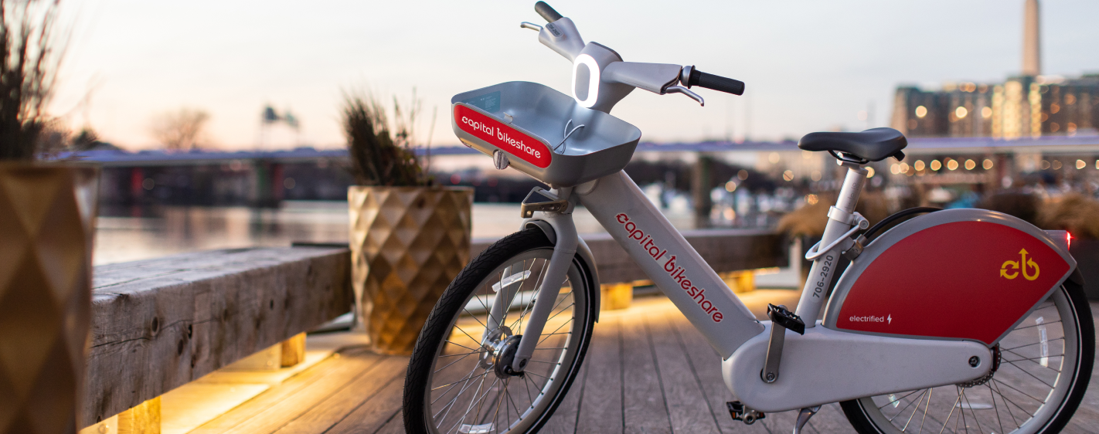
Capital Bikeshare Analytics Presentation
By O’Carson Fils and Julian Soler-Rivera
Notes:
Julian:

Slide 2
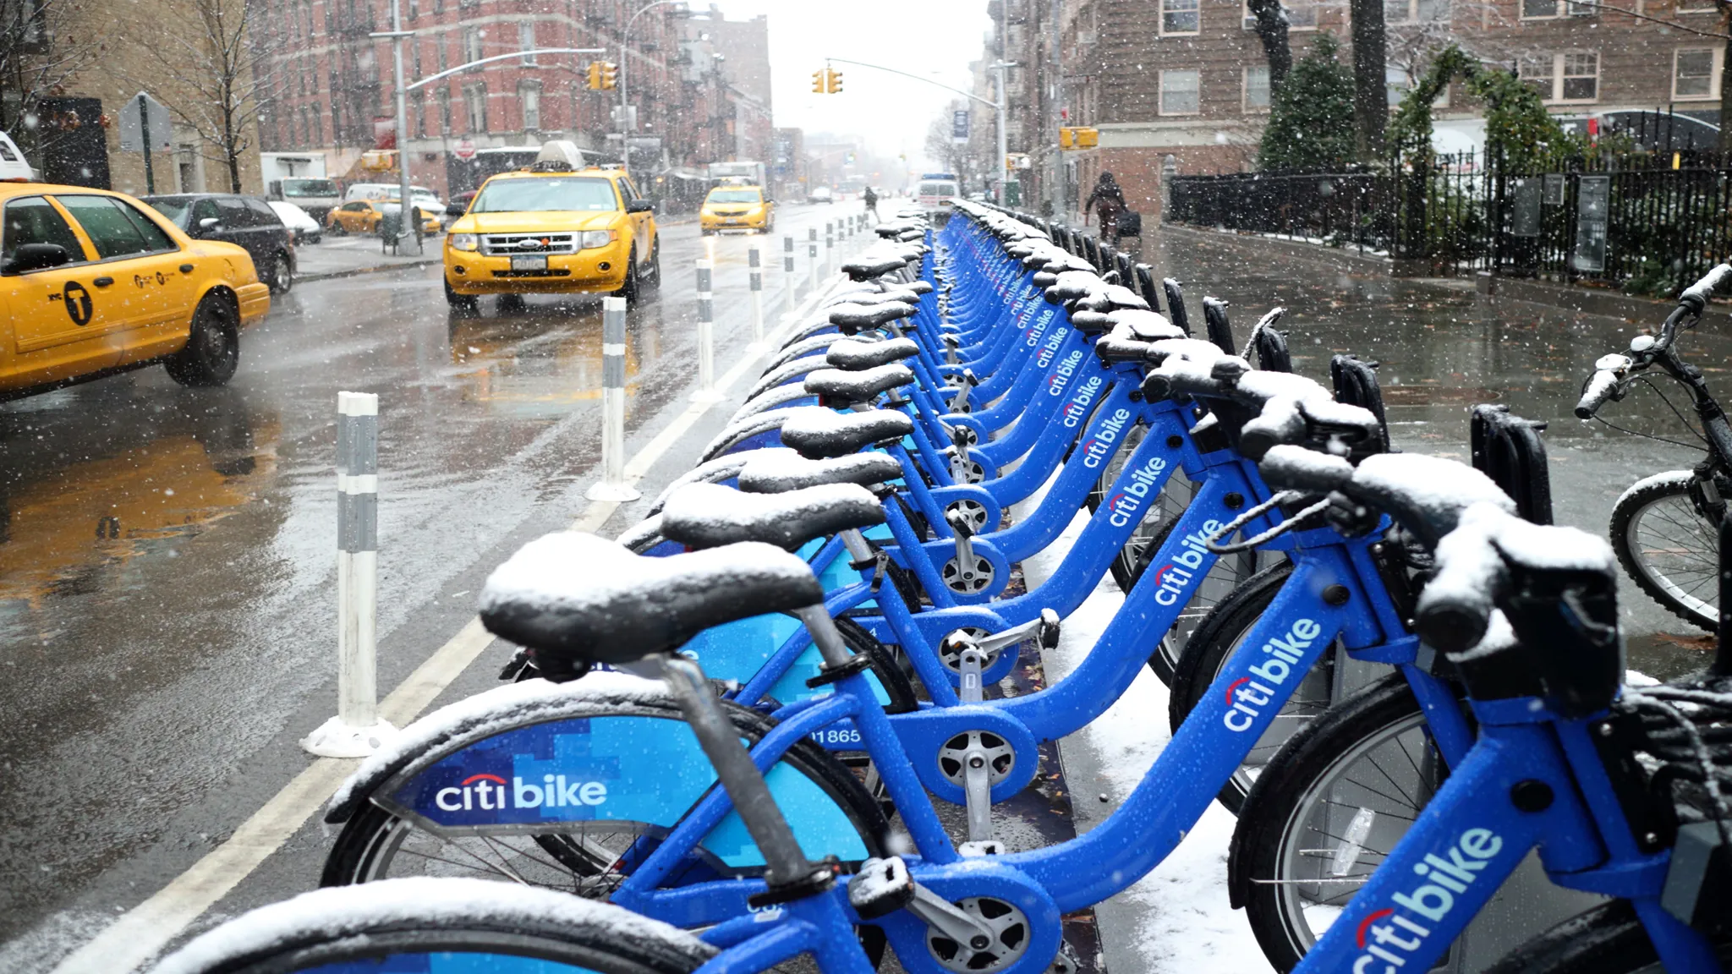
Introduction to Business Problem and Methodology
Capital Bikeshare is a bike rental company in Washington, D.C., with several thousand daily users
The number of users changes from day to day based on meteorological factors
To better forecast revenue a model is needed to better predict the amount of users per day
Notes:
Julian:

Slide 3
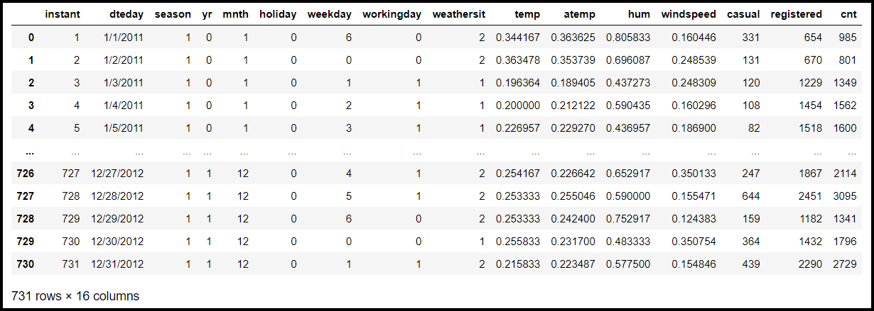
Data Inspection and Wrangling
For our predictive analysis, we chose your Bike Sharing Dataset from the UCI Machine Learning Repository:
Notes:
O’Carson:
Explain what the source and what UCI is
Explain 731x15 stats, what the columns are, and the time frame
Discuss how we fixed the column names

Slide 4
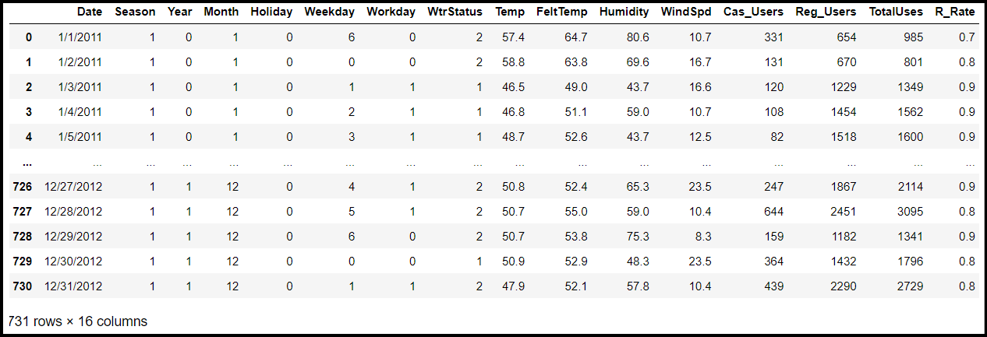
Data Inspection and Wrangling (2)
Column names were edited to be more user friendly
Values for Temperature, Humidity, and WindSpd were normalized
We created the column R-Rate to show the % of registered users
Notes:
O’Carson:

Slide 5
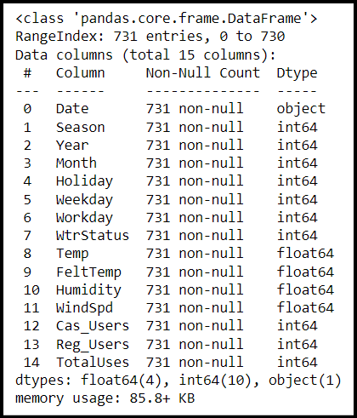
Data Inspection and Wrangling (3)
Thankfully, there were no null values in this dataset
Season, Year, Month, Holiday, Weekday, WorkingDay, and WtrStatus are all categorical/qualitative variables
Temp, FeltTemp, Humidity, WindSpd, Cas_Users, Reg_Users, and TotalUses are all numerical/quantitative variables
Notes:
Julian:

Slide 6
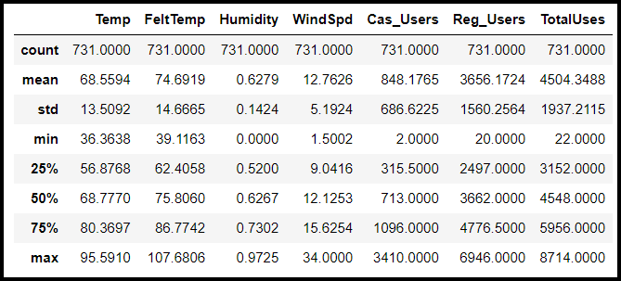
Key Summary Statistics
Qualitative variables like season were temporarily dropped in order to see statistics on quantitative variables
Key measures were mean, minimum, and maximum
Notes:
Julian:

Slide 7
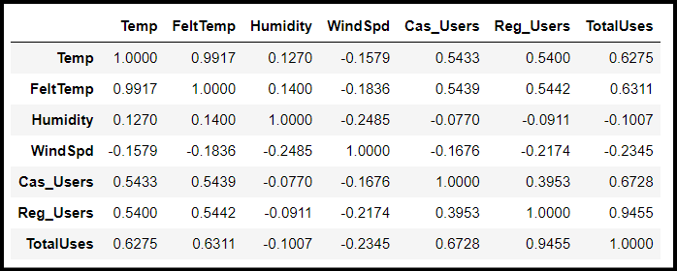
Correlations Analysis
Notice that the variables most highly correlated with TotalUses are temperature values
Humidity and WindSpd have weak, negative correlations
Of course, the number of Casual and Registered users on a given day effect the total bike usage
Notes:
O’Carson:

Slide 8
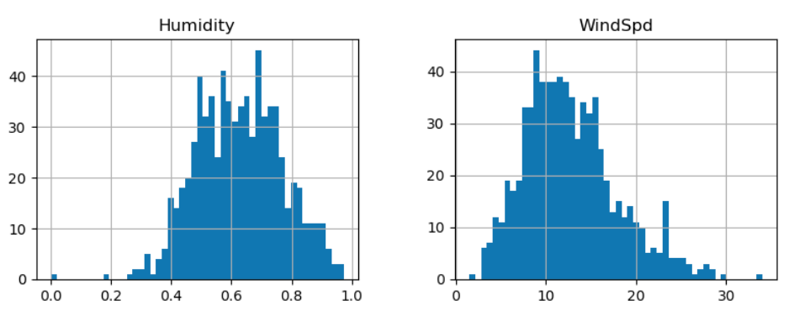
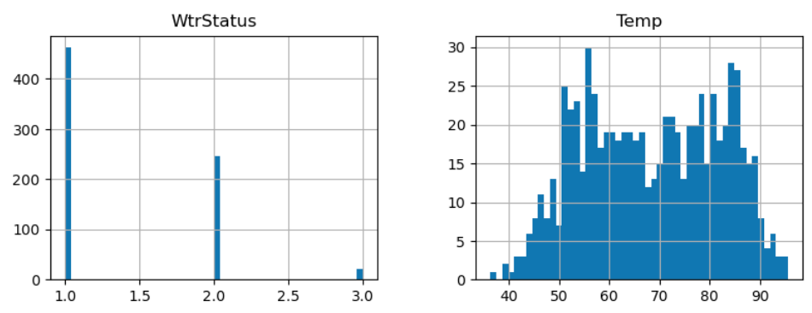
Histogram Visualizations
Relevant variables in data set displayed
Humidity ranged most between 40-75%
Wind speeds ranged between 8-17 mph
Most days were clear
Temperatures varied between 50-90 degrees
Notes:
O’Carson:

Slide 9
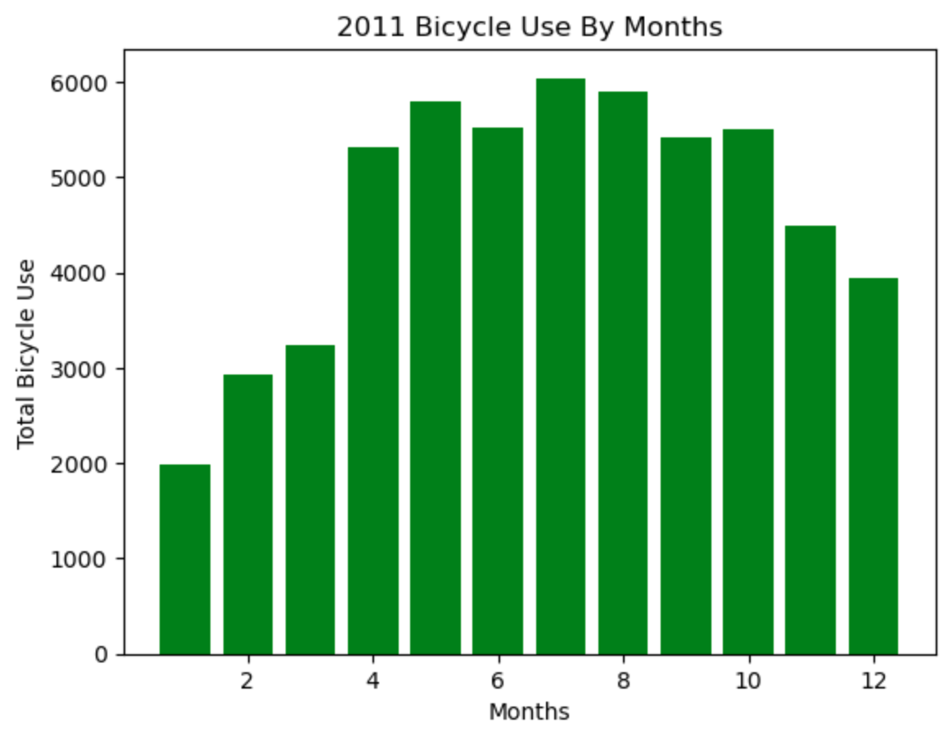
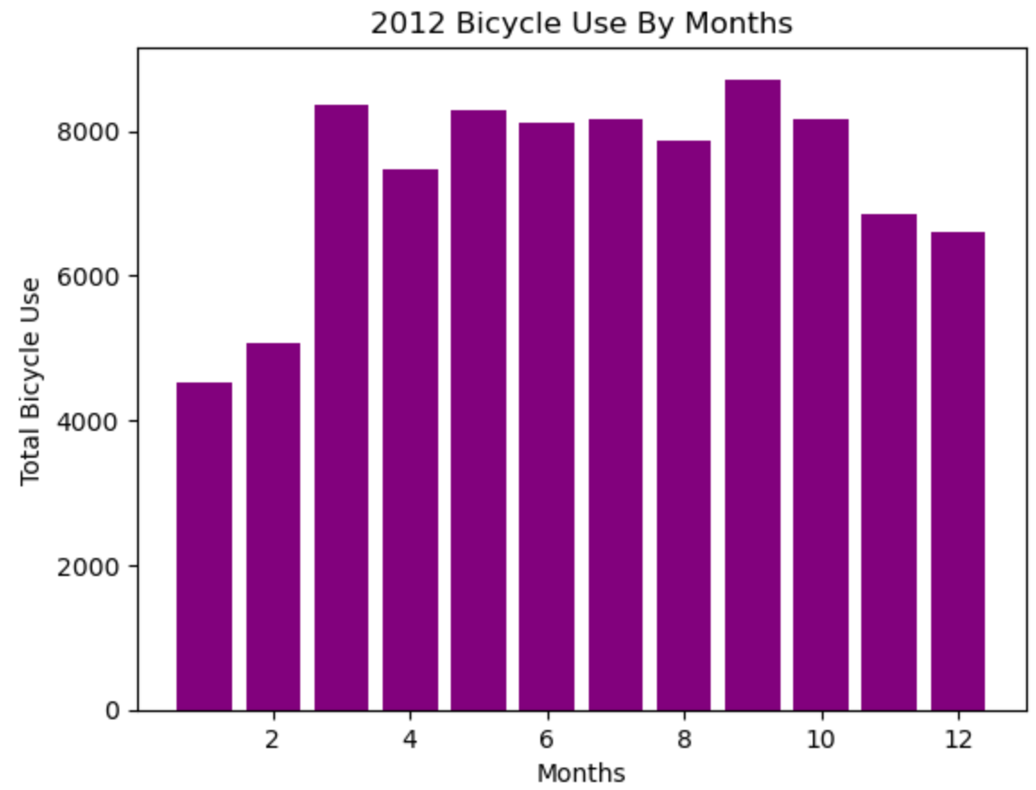
Yearly Service Observations
Usage seems consistent, but the range of data has risen in scale by 2000
More service use during Summer & Autumn months
Notes:
Julian:

Slide 10
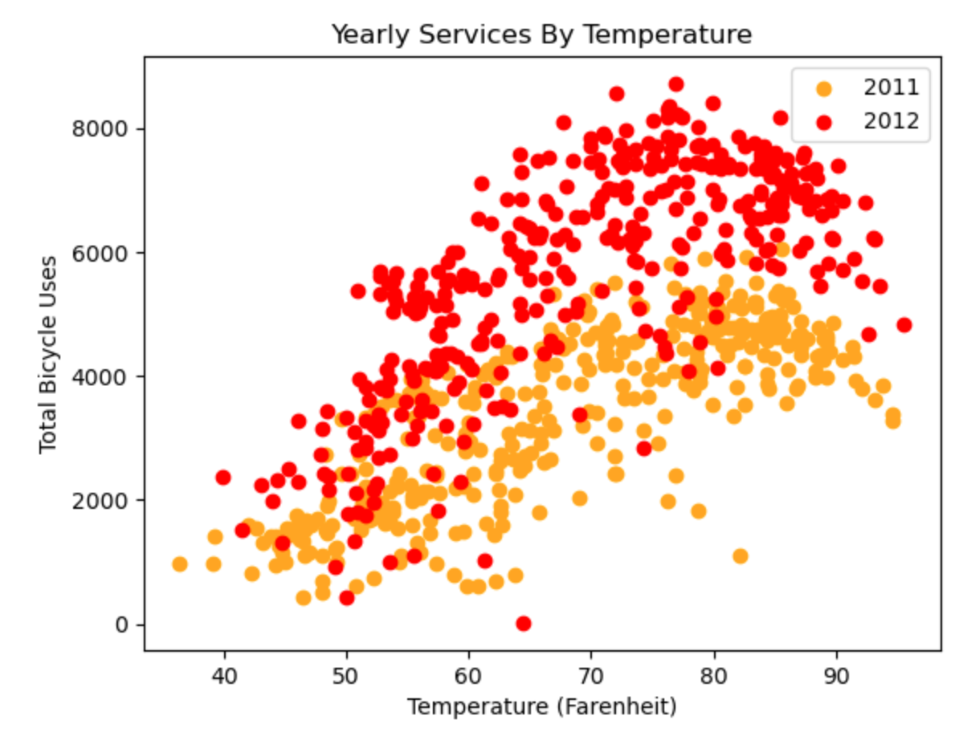
Yearly Trends
Concurs with positive correlation between temperature and service use
Increase in use of services by 25% from one year to the other
Notes:
Julian:

Slide 11
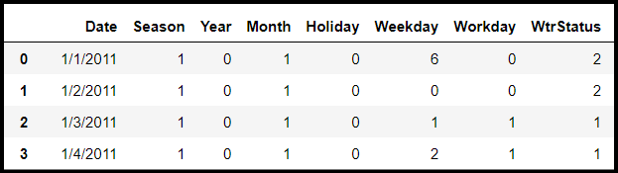
Encoding of Categorical Variables (Before)
All of these columns are categorical, which means they cannot be used in the linear regression model
We created binary columns for each of these
Notes:
O’Carson:

Slide 12
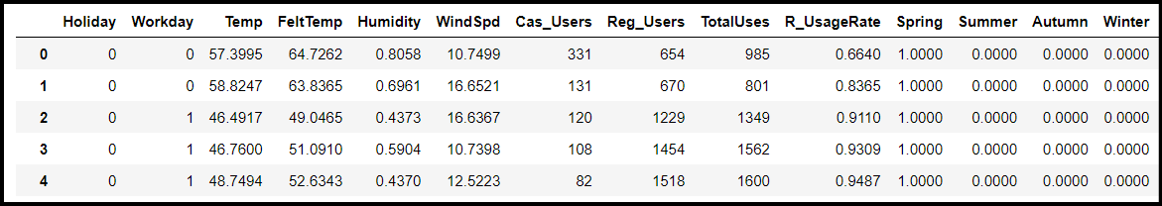
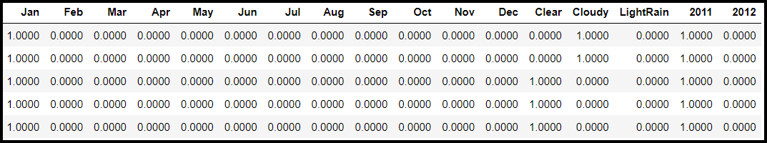
Encoding of Categorical Variables (After)
We were originally going to use a wide variety of columns in the dataset, but there are too many categorical variables (21)
Notes:
O’Carson:

Slide 13
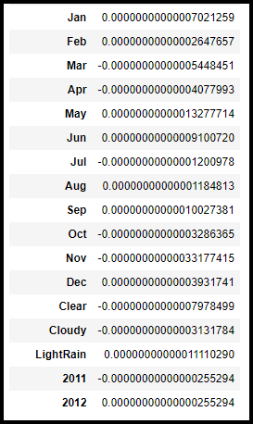
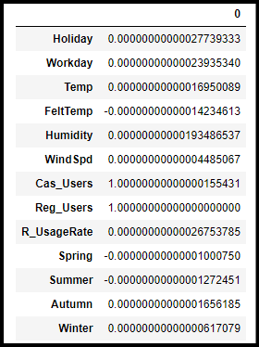
First Linear Regression Results
This generated very interesting results when we used the model to predict Y, the number of Total Users
These regression coefficients were extremely small, so we thought it would be best to reduce the number of categorical variables
Notes:
O’Carson:

Slide 14
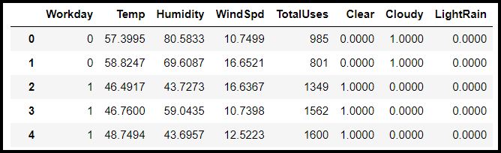
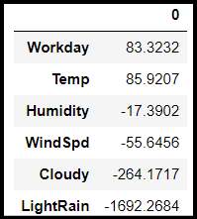
Regression Coefficient Interpretation
To this end, we dropped all of the categorical variables except the Workday, Clear, Cloudy, and, LightRain
We can see the effect that Temp, Humidify, and WindSpd have on the number of users
Workday and the weather status variables also have significant impact
Notes:
O’Carson:

Slide 15
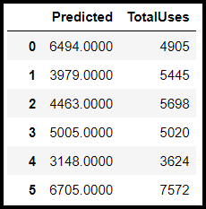
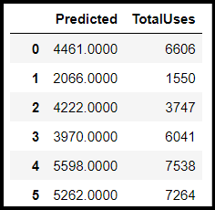
Evaluating the Model Predictions
In-Sample Evaluation
Out-of-Sample Evaluation
1385.84
1416.34
RMSE:
RMSE:
15.9%
16.2%
Notes:
Julian: Root mean squared error

Slide 16
Example Prediction with our Model
Users Prediction: 1928.38
Let's say that we are trying to predict the numbers of bike users on Jan 8th, 2024. (The day we return from winter break)
We have the following forecasts for variables that day:
Workday: 1 (It is a Monday)
Temp: 55
Humidity: 60
WindSpd: 12
Weather Status: Light Rain
Notes:
Julian:

Slide 17
Conclusion
Temperature and Adverse Weather Conditions are the environmental variables that have the largest effect on the numbers of users per day
Capital Bikeshare now has a model they can use to input environmental variables and predict the number of users
Notes:
Julian:

Slide 18
Business Recommendations
Include a rain poncho with small stations with bikes to incentivise the use of the bikes despite less than perfect weather conditions
These will be reusable so that they can be a permanent fixture
Can act as advertising by putting your logo on the back of the ponchos
Area of opportunity to incentivise registered users for different sized raincoats
More customer information could have been collected
Dataset could have been more detailed by including more information about registered users such as customer age groups, avg distance traveled, etc
Notes:
Julian:

Slide 19
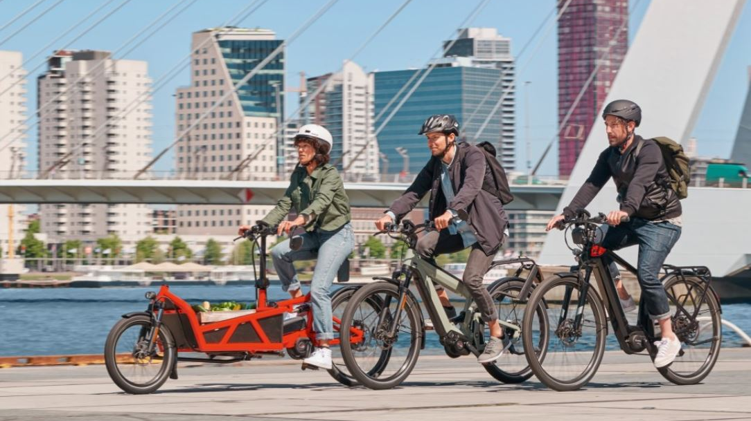
Questions?
Notes:
Julian:

